Slide 1


WP3 Data Quality Assurance
Dr Punit Gupta (UCD)

Slide 2
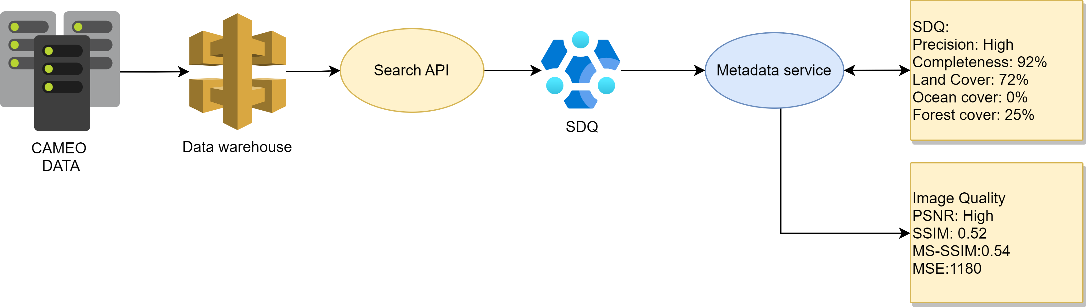


Working Model

Slide 3
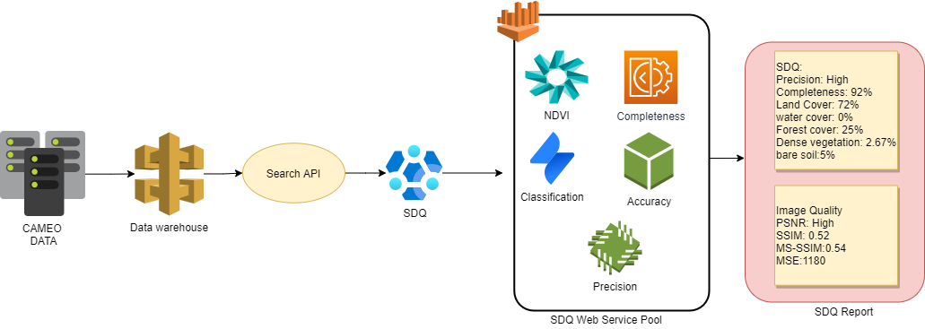
Working Model

Slide 4
Working Model

Slide 5
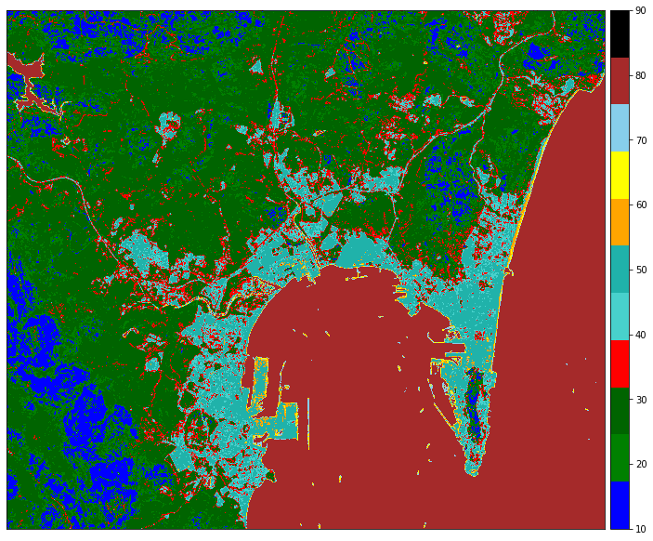
Land Classification using KNN

Slide 6
Land Classification using KNN

Slide 7
Current Working
Integration and testing with Dell sample data
Adding microservices and
Cloud detection service (ML model)
Atmospheric correction as quality
Thermal noise detection

Slide 8
